Slide 1
The Art of Convincing: Can AI Out-Persuade Humans?
Student’s Name
University of Hertfordshire

Slide 2
introduction
Motivation
AI models are increasingly used to generate persuasive text; understanding their effectiveness is critical for safety and alignment.
Research Question
What characteristics of claims and arguments influence initial/final persuasiveness ratings, and how do different prompt types and sources (AI vs Human) affect these metrics?

Slide 3
Overview if previous work related to the project
Anthropic (2024) — Released the Persuasion Dataset; 3,939 arguments from 5 Claude versions, human writers, and a control group
Bai et al. (2022) — Constitutional AI: training AI to follow human principles and avoid harmful persuasion
Cialdini (2001) — Principles of persuasion: reciprocity, commitment, social proof, authority, liking, scarcity

Slide 4
Overview if previous work related to the project
Tabular text data — 3,939 records, 8 columns
Columns: worker_id, claim, argument, source, prompt_type, rating_initial, rating_final, persuasiveness_metric
Dataset link: Anthropic/persuasion

Slide 5
Ethical implications
No personal data — worker IDs are anonymised codes (e.g. PQVTZECGNK3K)
Consent was obtained to use the data for this project – go to website and see the license.
Deceptive prompt type raises concerns — arguments designed to mislead; used for research analysis only, not deployment
Data stored locally and on Google Colab — no redistribution; analysis does not reproduce manipulative arguments verbatim.

Slide 6
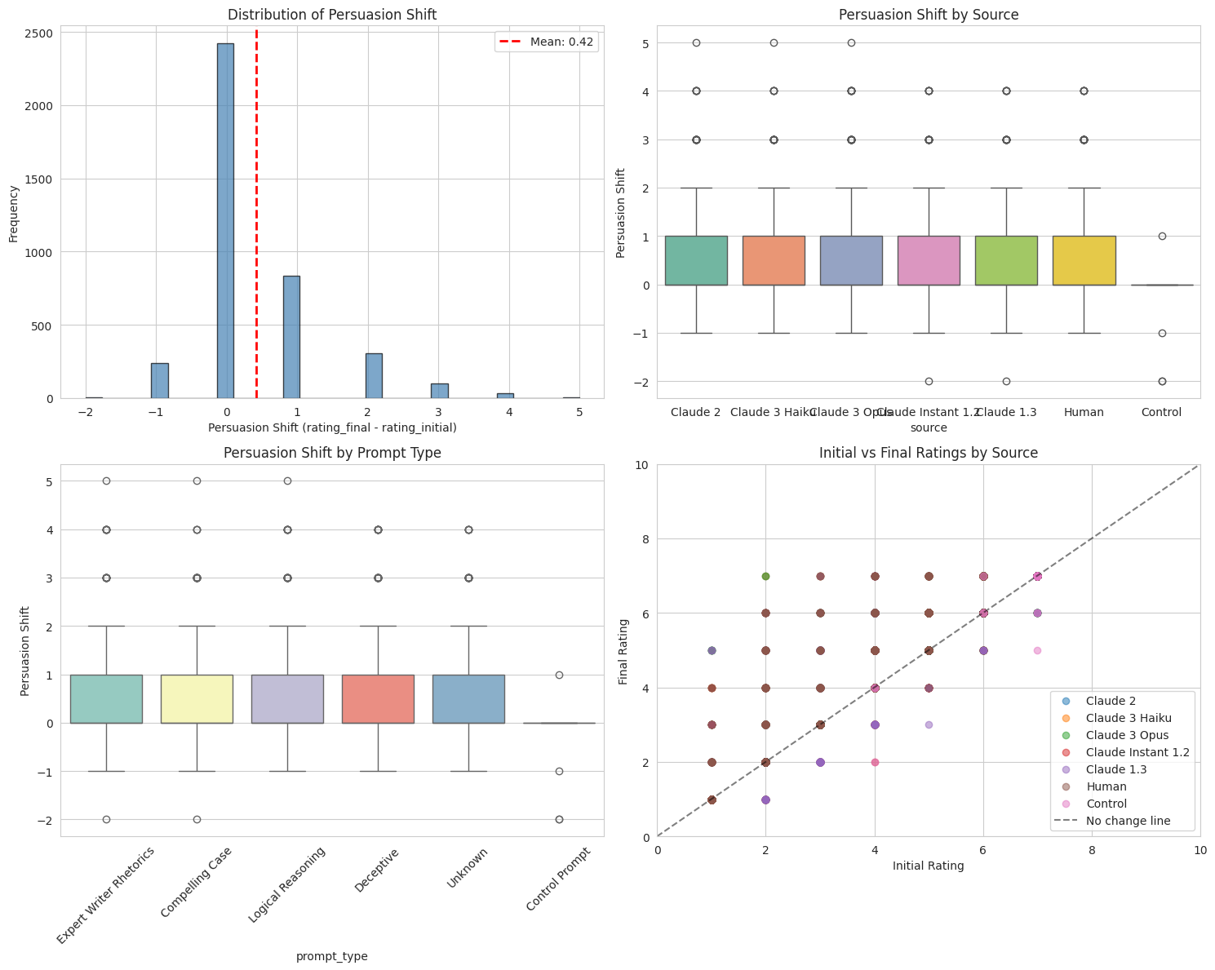
EDA
Key EDA Findings
Avg. initial rating: 4.20/7 | Avg. final rating: 4.61/7 | Mean persuasion shift: +0.42
82.7% minimal change | 11.1% more persuaded | 6.2% more opposed
Source distribution:
672 arguments per Claude model | 522 Human | 57 Control
522 missing prompt_type values (Human rows labelled “Unknown”)

Slide 7
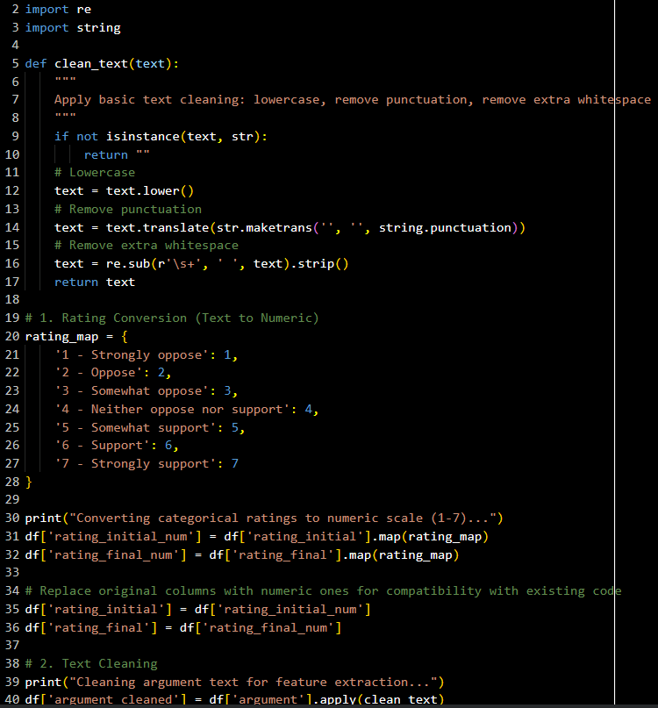
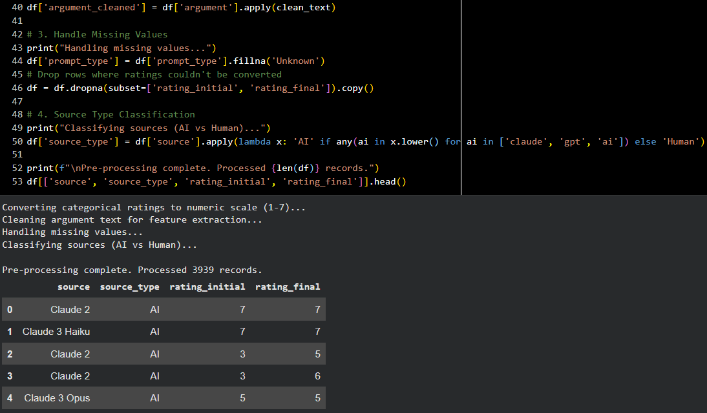
Pre-processing
Rating conversion: text labels (“1 - Strongly oppose”) mapped to numeric 1–7 scale
Text cleaning: lowercase, punctuation removal, whitespace normalisation on argument text
Missing values: 522 null prompt_type rows filled with “Unknown”

Slide 8
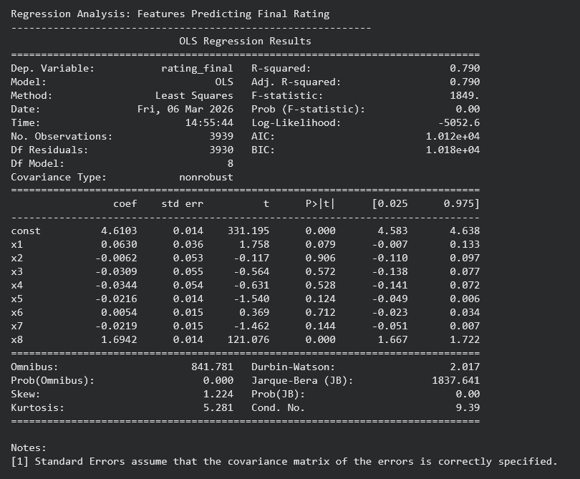
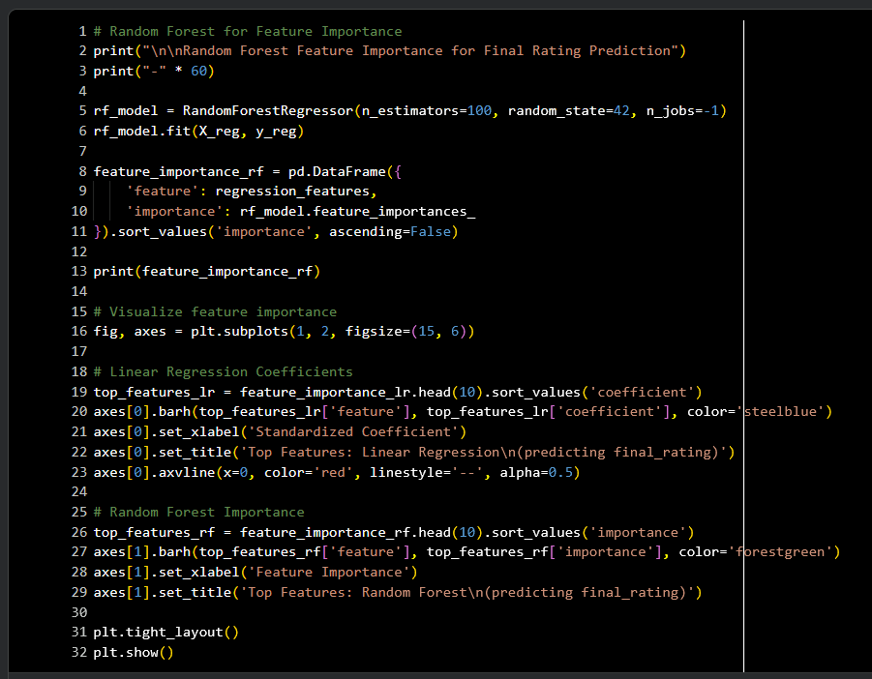
Model used
Three modelling approaches used in this project:
OLS Linear Regression — predicting final rating from text features + initial rating (R² = 0.79)
Random Forest Regressor — non-linear feature importance ranking (R² = 0.94)
QLoRA Fine-tuning (Unsloth) — TinyLLaMA-chat-4bit and LLaMA-3.2-1b-4bit fine-tuned for 3-class persuasion-shift classification (5 epochs, r=16, 4-bit NF4)

Slide 9
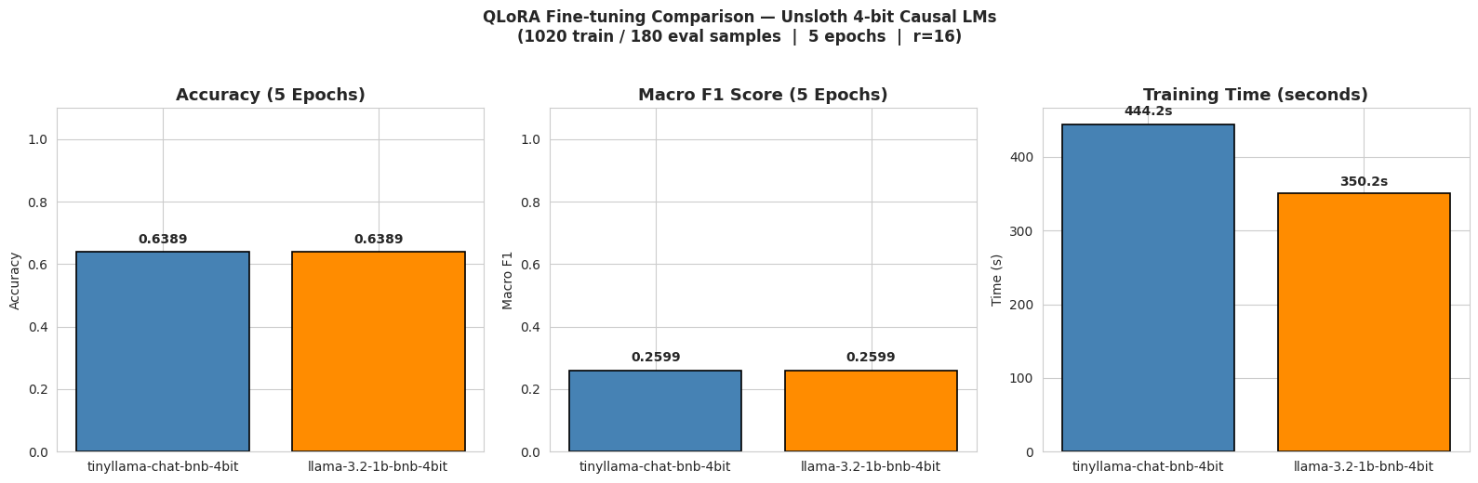
Model results
Regression Results
OLS: only rating_initial significant (p < 0.001, coeff = 1.69); text features not significant for final rating
RF: rating_initial dominates (importance = 0.81); argument_length (0.06) and avg_sentence_length (0.05) follow
QLoRA Results (5 epochs)
TinyLLaMA: Accuracy = 63.9%, F1 Macro = 0.26, Train time = 444s
LLaMA-3.2-1B: Accuracy = 63.9%, F1 Macro = 0.26, Train time = 350s (faster)
Both models predict Neutral class only; class imbalance (64% Neutral) limits performance

Slide 10
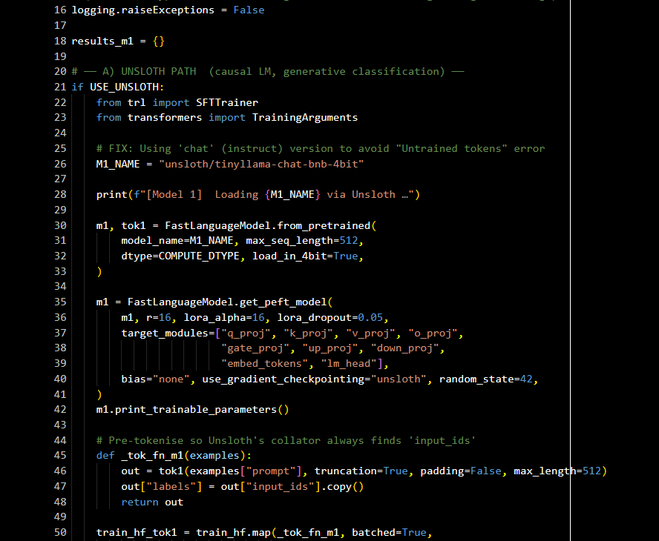
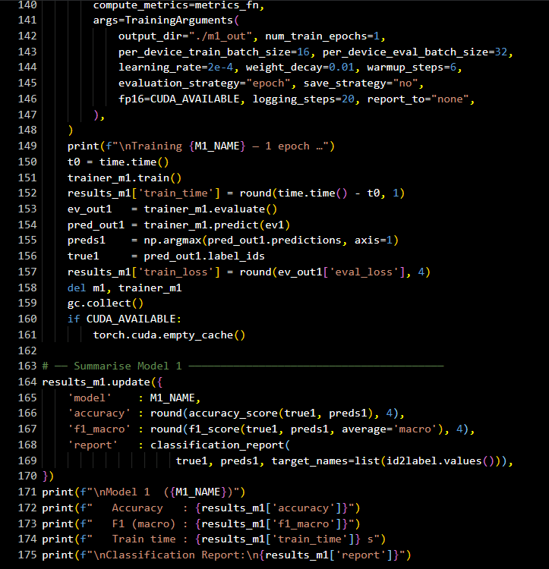
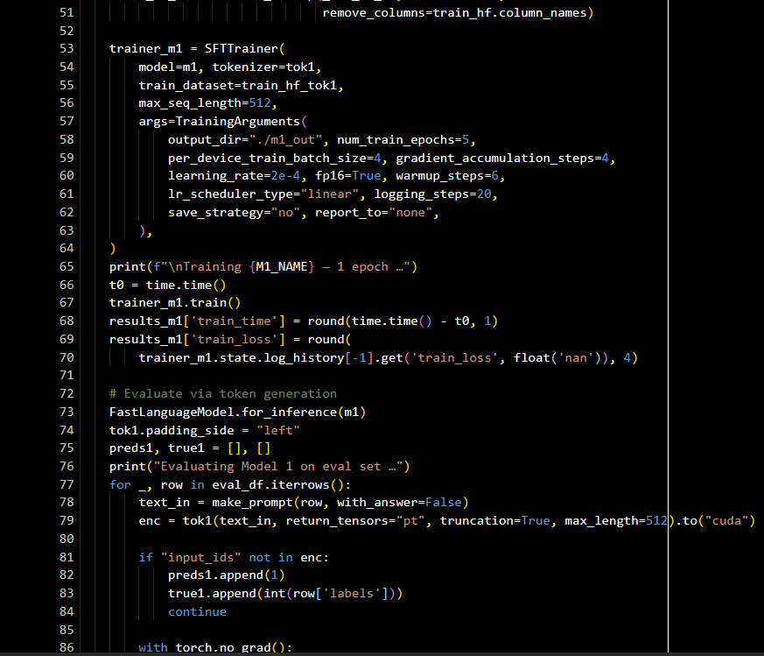
Hyperparameter tuning
r=16, lora_alpha=16, dropout=0.05 | Targets: q/k/v/o_proj | Epochs: 5, LR: 2e-4, batch: 4, grad_accum: 4
Effect of Epochs (1 vs 5):
Train loss dropped from ~1.76 (step 20) to ~0.34 (step 320) for TinyLLaMA across 5 epochs
Despite lower loss, generative models still defaulted to Neutral — class imbalance is the bottleneck, not hyperparameters
Next: use weighted loss or oversample minority classes to improve F1

Slide 11
analysis
Human arguments outperform AI (final rating 4.88 vs 4.56, p=0.0003); persuasion shift difference not significant (p=0.056)
Deceptive prompt achieves highest mean shift (0.47) among AI strategies; Expert Writer Rhetorics lowest (0.30)
Claude 3 Opus most persuasive AI source (shift = 0.48); Claude Instant 1.2 least (0.34)
63.9% QLoRA accuracy equals majority-class baseline — models failed to learn minority classes.

Slide 12
Summary and conclusions
Analysed Anthropic Persuasion Dataset (3,939 records) to measure persuasion shifts and identify drivers
Initial position strongly predicts final rating (OLS R²=0.79); text features alone explain little variance
Human arguments are statistically more persuasive than AI; Deceptive prompts most effective AI strategy; no significant prompt-source interaction
QLoRA fine-tuning (63.9% accuracy) reveals class imbalance challenge; LLaMA-3.2-1B trains 21% faster than TinyLLaMA
Next steps: BERT-based classification, weighted loss, larger dataset fine-tuning, sentiment analysis pipeline

Slide 13
references
Barale, A. (2021) ‘“Who inspires who?” Aesthetics in front of AI art’, Philosophical Inquiries, 9(2), pp. 195–220.
Burtell, M. and Woodside, T. (2023) ‘Artificial Influence: An Analysis Of AI-Driven Persuasion’. arXiv. Available at: https://doi.org/10.48550/arXiv.2303.08721.
Dehnert, M. and Mongeau, P.A. (2022) ‘Persuasion in the age of artificial intelligence (AI): Theories and complications of AI-based persuasion’, Human Communication Research, 48(3), pp. 386–403.
Fischetti, M.R. (2025) Decoding the Art of Persuasion: Structures and Strategies for Human and AI Dynamics. Digital Index Editore. Available at: https://books.google.com/books?hl=en&lr=&id=GlJAEQAAQBAJ&oi=fnd&pg=PT2&dq=Art+Convincing+AI+Persuade+Humans&ots=qD9zmUeYFP&sig=QUkr_-2_axwCi9GEn6MYg4iVB_s (Accessed: 7 February 2026).
Huang, G. and Wang, S. (2023) ‘Is artificial intelligence more persuasive than humans? A meta-analysis’, Journal of Communication, 73(6), pp. 552–562.
Karinshak, E., Liu, S.X., Park, J.S. and Hancock, J.T. (2023) ‘Working With AI to Persuade: Examining a Large Language Model’s Ability to Generate Pro-Vaccination Messages’, Proceedings of the ACM on Human-Computer Interaction, 7(CSCW1), pp. 1–29. Available at: https://doi.org/10.1145/3579592.
Lin, H., Czarnek, G., Lewis, B., White, J.P., Berinsky, A.J., Costello, T., Pennycook, G. and Rand, D.G. (2025) ‘Persuading voters using human–artificial intelligence dialogues’, Nature, pp. 1–8.
Luciano, F. (2024) ‘Hypersuasion – On AI’s Persuasive Power and How to Deal with It’, Philosophy & Technology, 37(2), pp. 64, s13347-024-00756–6. Available at: https://doi.org/10.1007/s13347-024-00756-6.
Millet, K., Buehler, F., Du, G. and Kokkoris, M.D. (2023) ‘Defending humankind: Anthropocentric bias in the appreciation of AI art’, Computers in Human Behavior, 143, p. 107707.
Ruiz-Arellano, A.E., Mejía-Medina, D.A., Castillo-Topete, V.H., Fong-Mata, M.B., Hernández-Torres, E.L., Rodríguez-Valenzuela, P. and Berra-Ruiz, E. (2022) ‘Addressing the use of artificial intelligence tools in the design of visual persuasive discourses’, Designs, 6(6), p. 124.

Slide 14
THANK YOU

